Slide 1




Plico is powering the future….
…one rooftop at a time.
Authorised Plico Referrer Presentation
Referrer Name:
Unauthorised distribution of this material is not sanctioned by Plico. Plico has no contractual or employment relationship with any referrers.

Slide 2






Who is Plico?
Plico is a leading Australian clean energy company building a sustainable energy grid for the future. ​
​
​
Plico’s Solar Power System includes solar panels, a battery and hybrid inverter that enables members to generate, store and monitor their own clean power to use day and night. Plico’s Battery Only System can be paired with existing solar panels to store your clean energy for use when the sun goes down.
Plico is putting the power back into the hands of the community, allowing people to save money, enjoy blackout protection, and generate and store their own clean energy.
Plico is powered by an award-winning team and a multi-million dollar backing from a sustainable investment company SUSI, who have over a decade of experience successfully funding clean energy projects.​
Plico manages WA’s first VPP (virtual power plant), with each individual Plico system having the capability to be aggregated to provide valuable services and assistance to the local energy grid.​

Slide 3
The benefits.
1
Save on your power bill
4
Ongoing support for up to 10 years
2
One low weekly instalment
5
Reduce your carbon footprint
3
6
An app to track everything
Enjoy protection from blackouts
An app to track everything

Slide 4
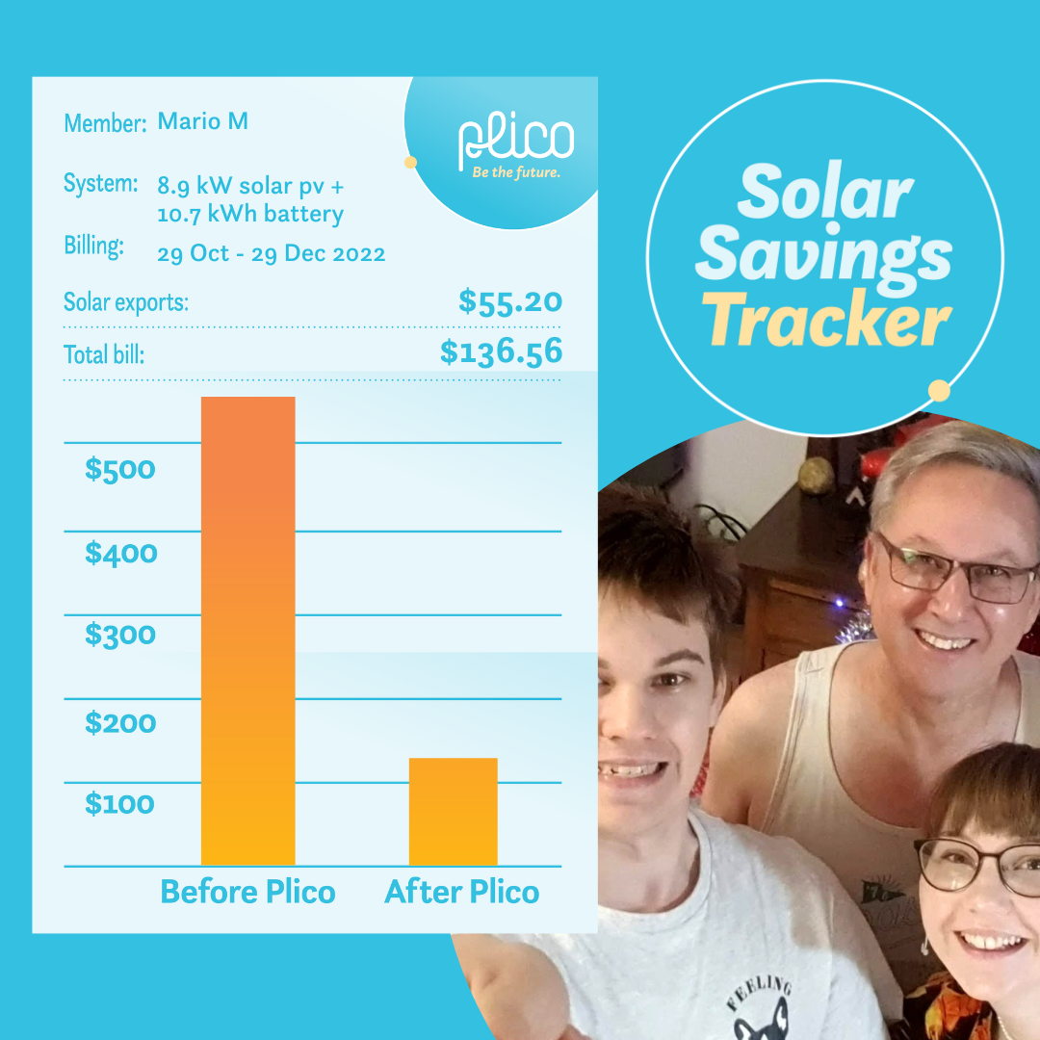
Save on your power bill.
​
Mario and his family save over $400 on their power bill with Plico.

Slide 5

Use solar energy 24/7.
​

Slide 6

Beat blackouts.
​

Slide 7
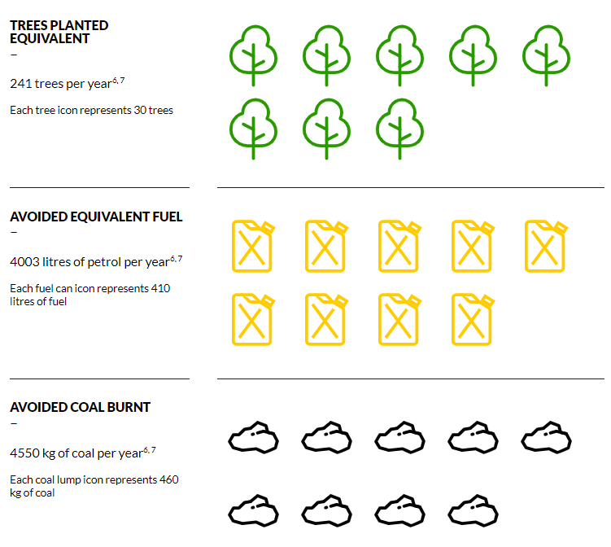
Protect the planet.
​
A snapshot of how you can make a positive change. The reduction in your annual carbon emissions is equivalent to...

Slide 8
Join Plico today...
and they will reward you with cold hard cash (to spend anywhere Mastercard is accepted).
You can start saving $$$ on your energy bills!
Call their switched-on team today or use your friend’s referral link!

Slide 9










Get in touch to find out how much you could save with a Plico system.
1300 175 426
connect@plicoenergy.com.au
plicoenergy.com.au
@plicoenergy

